Slide 1
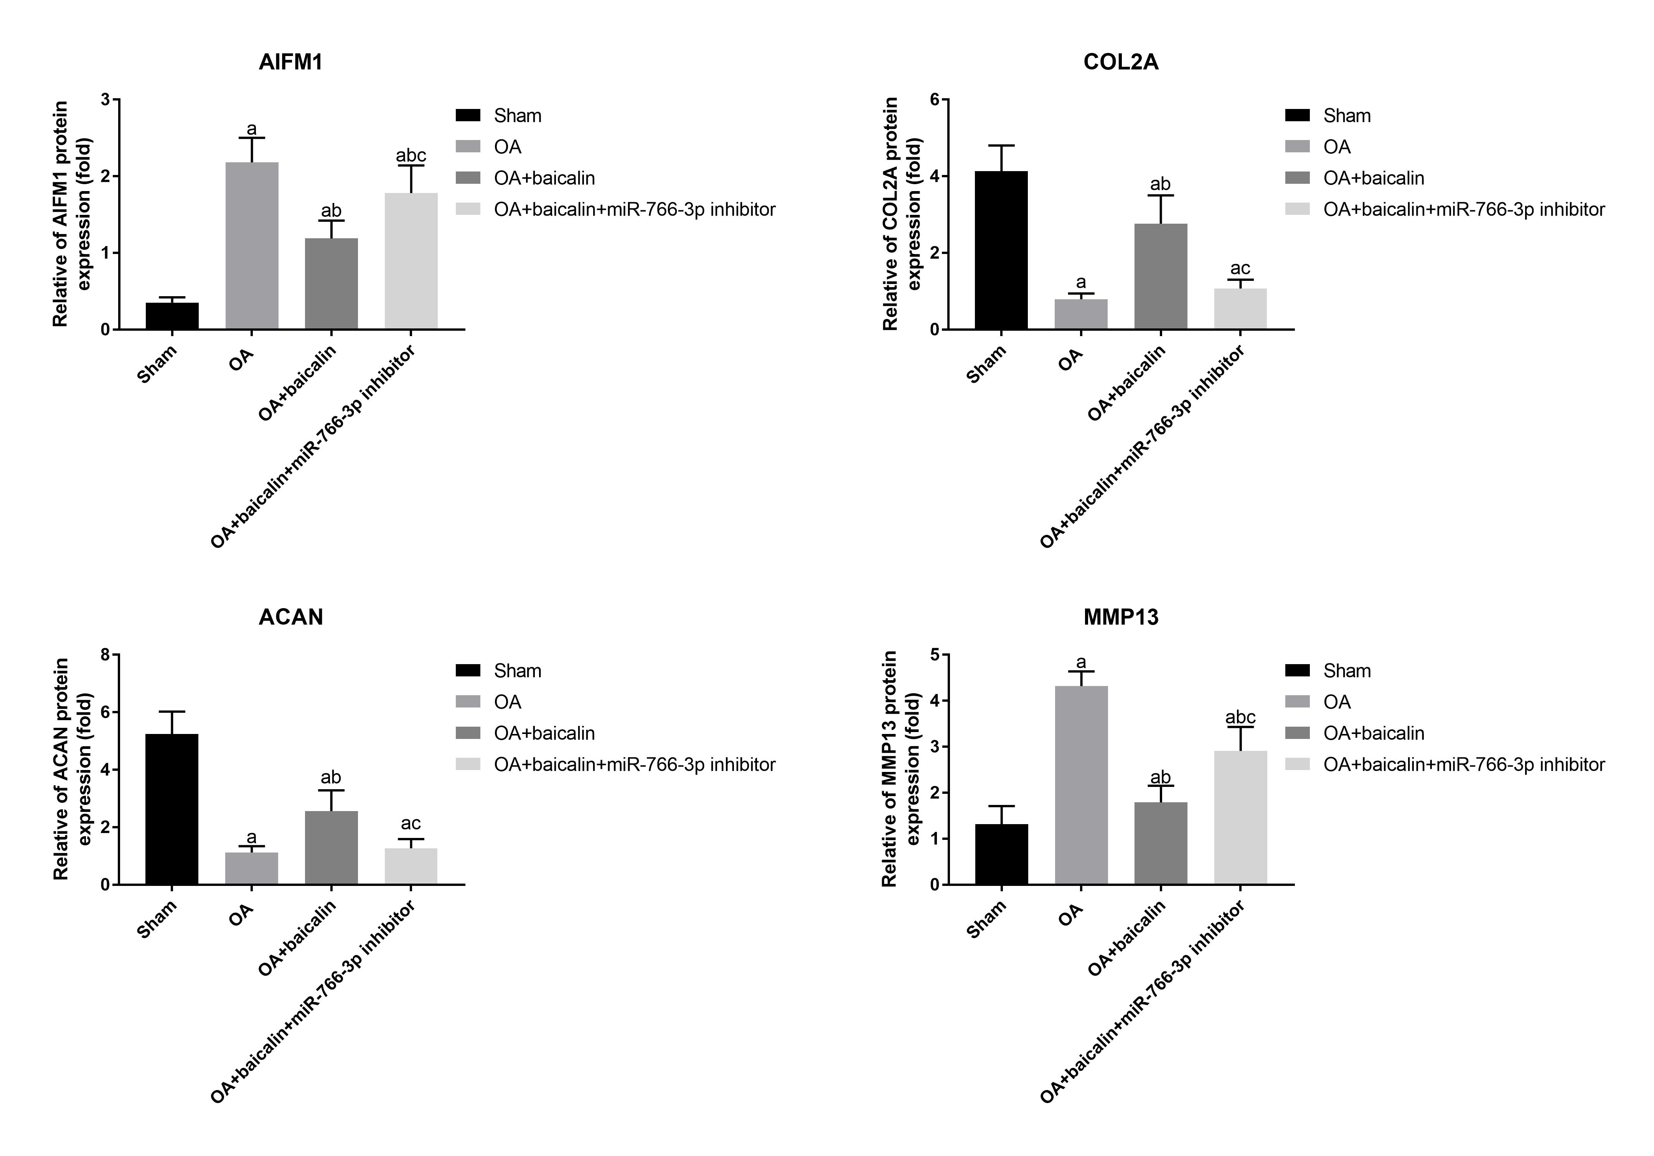
A
B
1
2
3
4
AIFM1
COL2A
ACAN
MMP13
GAPDH

